Slide 1
Enhancers of Encoding: Generation and Spacing
The Generation Effect
The Spacing Effect
Click here for A Closer Look
Chapter 5

Slide 2
Enhancers of Encoding: Generation and Spacing
It makes a difference if you’re paying attention, it makes a difference if, at the time, you elaborate.
The generation effect: Episodic learning is better if we can generate the target information from memory compared to when the information is presented to us by another person.
The spacing effect: Encoding across multiple study trials with the same information is optimal following a particular pattern of temporal sequencing of the study trials.
Chapter 5

Slide 3
The Generation Effect
The term generation effect describes the observed phenomenon that you are more likely to remember information you retrieve or generate (during study) than information that you simply receive and attempt to “memorize.”
The generation effect was first described following an experiment (Slamecka & Graf, 1978) in which participants learned word pairs in one of two ways.
Generating information from memory is thought to be a more powerful encoding event than merely processing externally presented information because both elaboration and greater attention are required for generation.
Chapter 5

Slide 4
The Spacing Effect
Massed practice: many trials with the same stimulus are undertaken without interruption.
Distributed practice: the trials with the same stimulus are separated by other stimuli.
Chapter 5

Slide 5
The spacing effect
Spacing effect: As Ebbinghaus himself put it, “with any considerable number of repetitions a suitable distribu­tion of them over a space of time is decidedly more advantageous than the mass­ing of them at a single time” (p. 89).
Encoding variability: the encoding of different aspects of a stimulus as different features are selected for encoding in subsequent encounters.

Slide 6
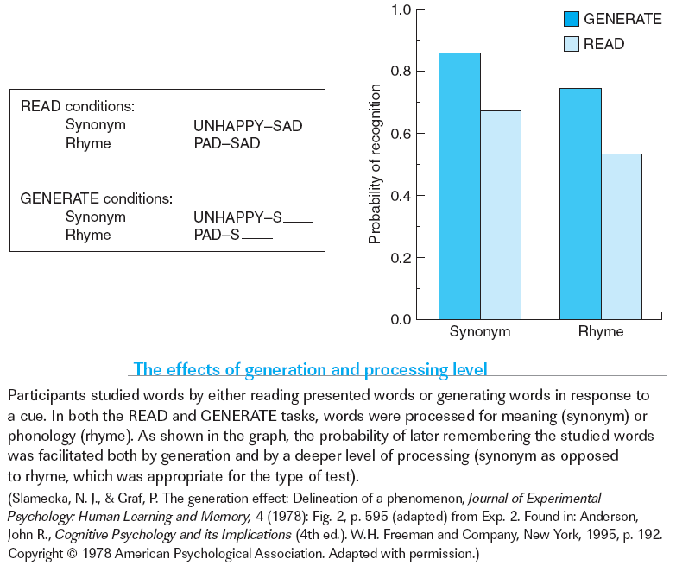
The Spacing Effect
Chapter 5

Slide 7
Episodic Encoding, Binding, and the Medial Temporal Lobe
Encoding information into episodic memory involves attention and elaboration, which rely on the frontal lobes.
The hallmark of episodic encoding is the binding together of the various features of a stimulus or event into an integrated memory representation.
The medial temporal lobe has been shown to be a convergence zone; a region that receives highly processed input from many brain areas.
Chapter 5

Slide 8
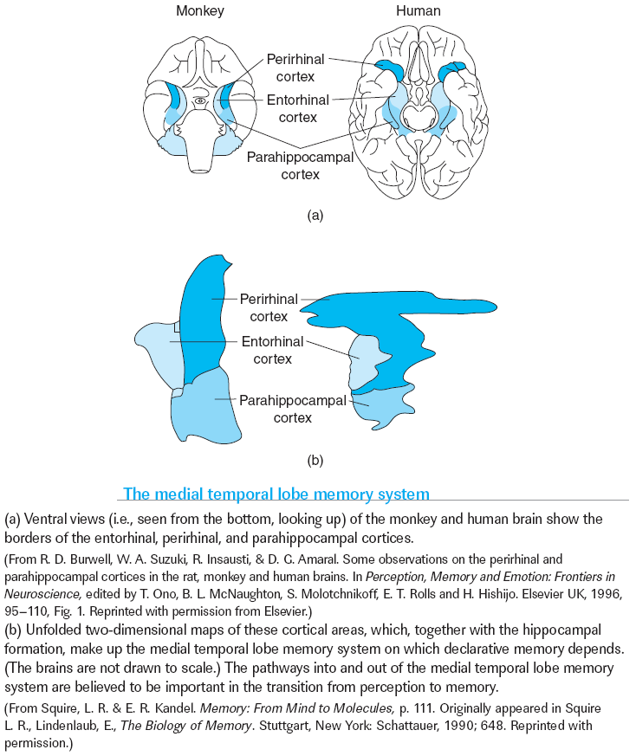
Chapter 5

Slide 9
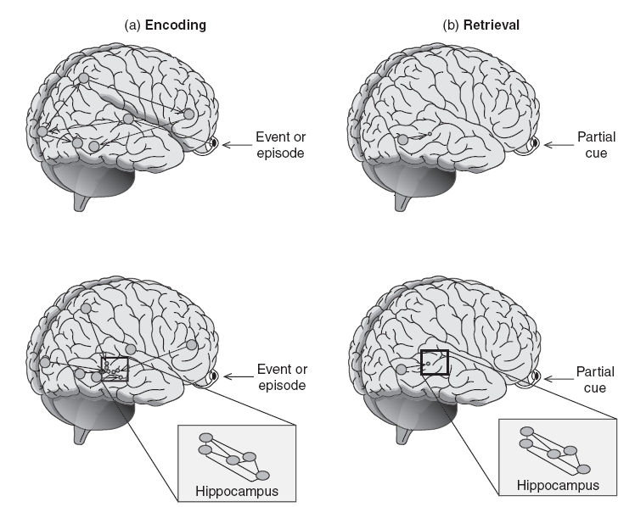
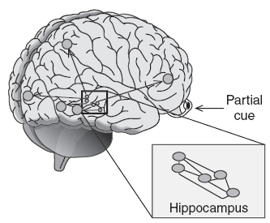
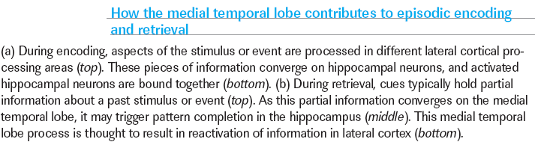
Chapter 5

Slide 10
Consolidation: The Fixing of Memory
Encoded episodic memories undergo consolidation, a process that modifies these rep­resentations such that they become more stable over time and ultimately exist inde­pendently of the medial temporal lobes.
Chapter 5
Notes:
Comprehension Check:
What are the major factors that affect encoding efficacy?
How does the medial temporal lobe support encoding and consolidation?

Slide 11
Consolidation
Evidence for consolidation comes from the observation that H.M.’s, and other amnesic patients’, retrograde amnesia is temporally graded: following removal of the medial temporal lobes, H.M. could still recall child­hood memories, but he had difficulty remembering events that happened during the years immediately preceding the surgery.
The medial temporal lobes are necessary for retrieving unconsolidated memories but, once consolidated, memories can be retrieved directly from lateral cortical regions.

Slide 12
Nondeclarative Memory Systems
Priming
Perceptual Priming
Conceptual Priming
Beyond Priming: Other Forms of Nondeclarative Memory
Skill Learning
Habit Memory
Conditioned Associations
Chapter 5
Notes:
Comprehension Check:
1. What factors lead to forgetting?
2. How do blocking and suppression account for forgetting?

Slide 13
Nondeclarative Memory Systems
The cognitive and neurobiological mechanisms that support declarative memory— and lead to forgetting—were best explored through our discussion of episodic memory, one form of declarative memory.
We experience other forms of long-term memory quite differently.
These other forms are known collectively as non-declarative (or implicit) memory.
Chapter 5

Slide 14
Perceptual Priming
Perceptual priming reflects the consequences of perceptual learning, and thus is highly dependent on the degree of perceptual overlap between the initial encounter with the stimulus and repeated ones.
Perceptual priming has been observed in all modalities tested (vision, audition, and touch), suggesting that it reflects a general form of learning in perceptual representation systems (Tulving & Schacter, 1990).
Chapter 5

Slide 15
Perceptual Priming
Because patients whose amnesia results from injury to the medial temporal lobes show intact perceptual priming, this form of memory cannot depend on the mechanisms that support declarative memory.
Repetition suppression observed in studies of nonhuman primates and rats; that is, a reduced firing rate of neurons in visual regions with repeated exposure to a stimulus

Slide 16
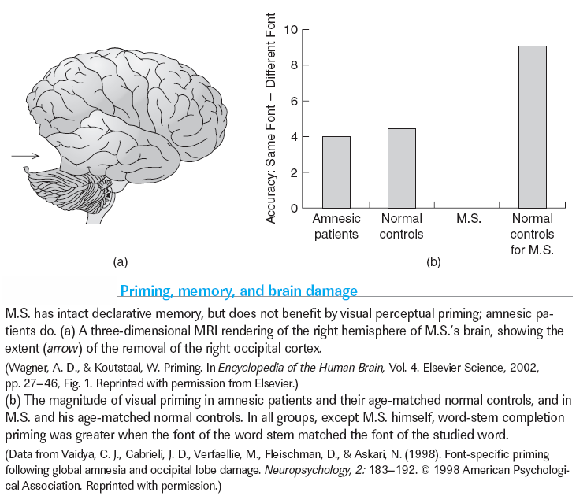
Chapter 5

Slide 17
Conceptual Priming
Conceptual priming, which results in facilitated processing of the meaning of a word, is demonstrated by the category ex­emplar generation task.
Neuroimaging studies of the healthy human brain during conceptual priming have revealed changes in frontal and temporal lobe activation.
The increased accessibility of sought semantic information as a result of priming serves to decrease demands on this retrieval process. In this way priming decreases the cognitive effort required to retrieve relevant information.
Chapter 5

Slide 18
Beyond Priming: Other Forms of Nondeclarative Memory
Skill Learning (expertise)
Habit Memory
Conditioned Associations
Chapter 5
Notes:
Although priming is arguably the best understood form of nondeclarative memory, there are other memory systems that operate independently of the medial temporal lobes to acquire and store knowledge that can be unconsciously or implicitly ex­pressed. These other nondeclarative systems support skilled behavior the acquisition of stimulus–response habits, and the formation and expression of conditioned asso­ciations. Learning within these systems is typically gradual and incremental. (p. 233)

Slide 19
Habit Memory
Nondeclarative memory also encompasses the acquisition of stimulus–response habits, habits that emerge through the slow accumulation of knowledge about the predictive relation between a stimulus and a response.
The acquisition and expression of habit memories has been assessed using the probabilistic classification task, in which partici­pants learn to predict one of two possible outcomes from a set of cues, each cue bearing a probabilistic relation to the outcome.
The basal ganglia become increasingly in­volved across the course of habit learning, whereas the declarative memory system appears to shut down.
Chapter 5

Slide 20
Conditioned Associations
The simplest form of conditioning, referred to as classical conditioning, entails learning a predictive relationship between two successive stimuli such that a response that is triggered by an initial stimulus (the unconditioned stimulus) prior to learning comes to be triggered by a second stimulus (the conditioned stimulus) that predicts onset of the unconditioned stimulus.
The formation of a conditioned association depends on the degree to which the presence of one stimulus predicts the occurrence of the other.
Chapter 5
Notes:
Comprehension Check:
1.How do perceptual and conceptual priming affect cognition?
2. What are the stages of skill learning?

